Slide 1
Code Quality Report
Submitted by TEAM BUG_INSPECTORS

Slide 2
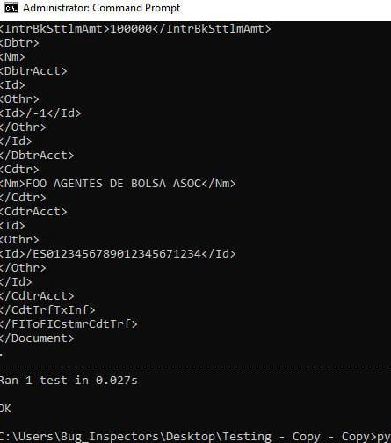
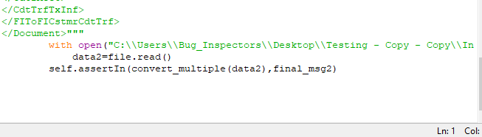
Unit testing for all components
Unit testing was done using the unittest module for python.
Three test cases were used for implementing the unit testing procedure.
The program took 0.027s to pass all test cases.

Slide 3
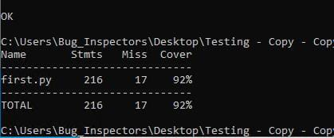
Test Coverage report
We implemented Test coverage using the coverage module in python.
The report result received initially was merely 80%
We then iterated a few lines in our code to later get a coverage of 92%.

